Slide 1
The Book of 2nd Samuel
SOURCES:
MacArthur. The MacArthur Study Bible. Tennessee: Thomas Nelson, Inc., 2006.
McGee, J. Vernon. Malachi: Thru The Bible Commentary Series-The Prophets. Tennessee: Thomas Nelson, Inc., 1991.
Ryrie, Charles: Ryrie Study Bible: Expanded Edition. Chicago: The Moody Bible Institute of Chicago, 1995.
Tucker, Kent: Share Your Faith Ministries, California.
“Scriptures taken from the NEW AMERICAN STANDARD BIBLE®, Copyright © 1960, 1962, 1963, 1968, 1971, 1972, 1973, 1975, 1977, 1995 by The Lockman Foundation. Used by permission.”
AUTHOR
Mervin W. Tapsfield
Sword of the Spirit Studies
www.swordofthespiritstudies.com

Slide 2
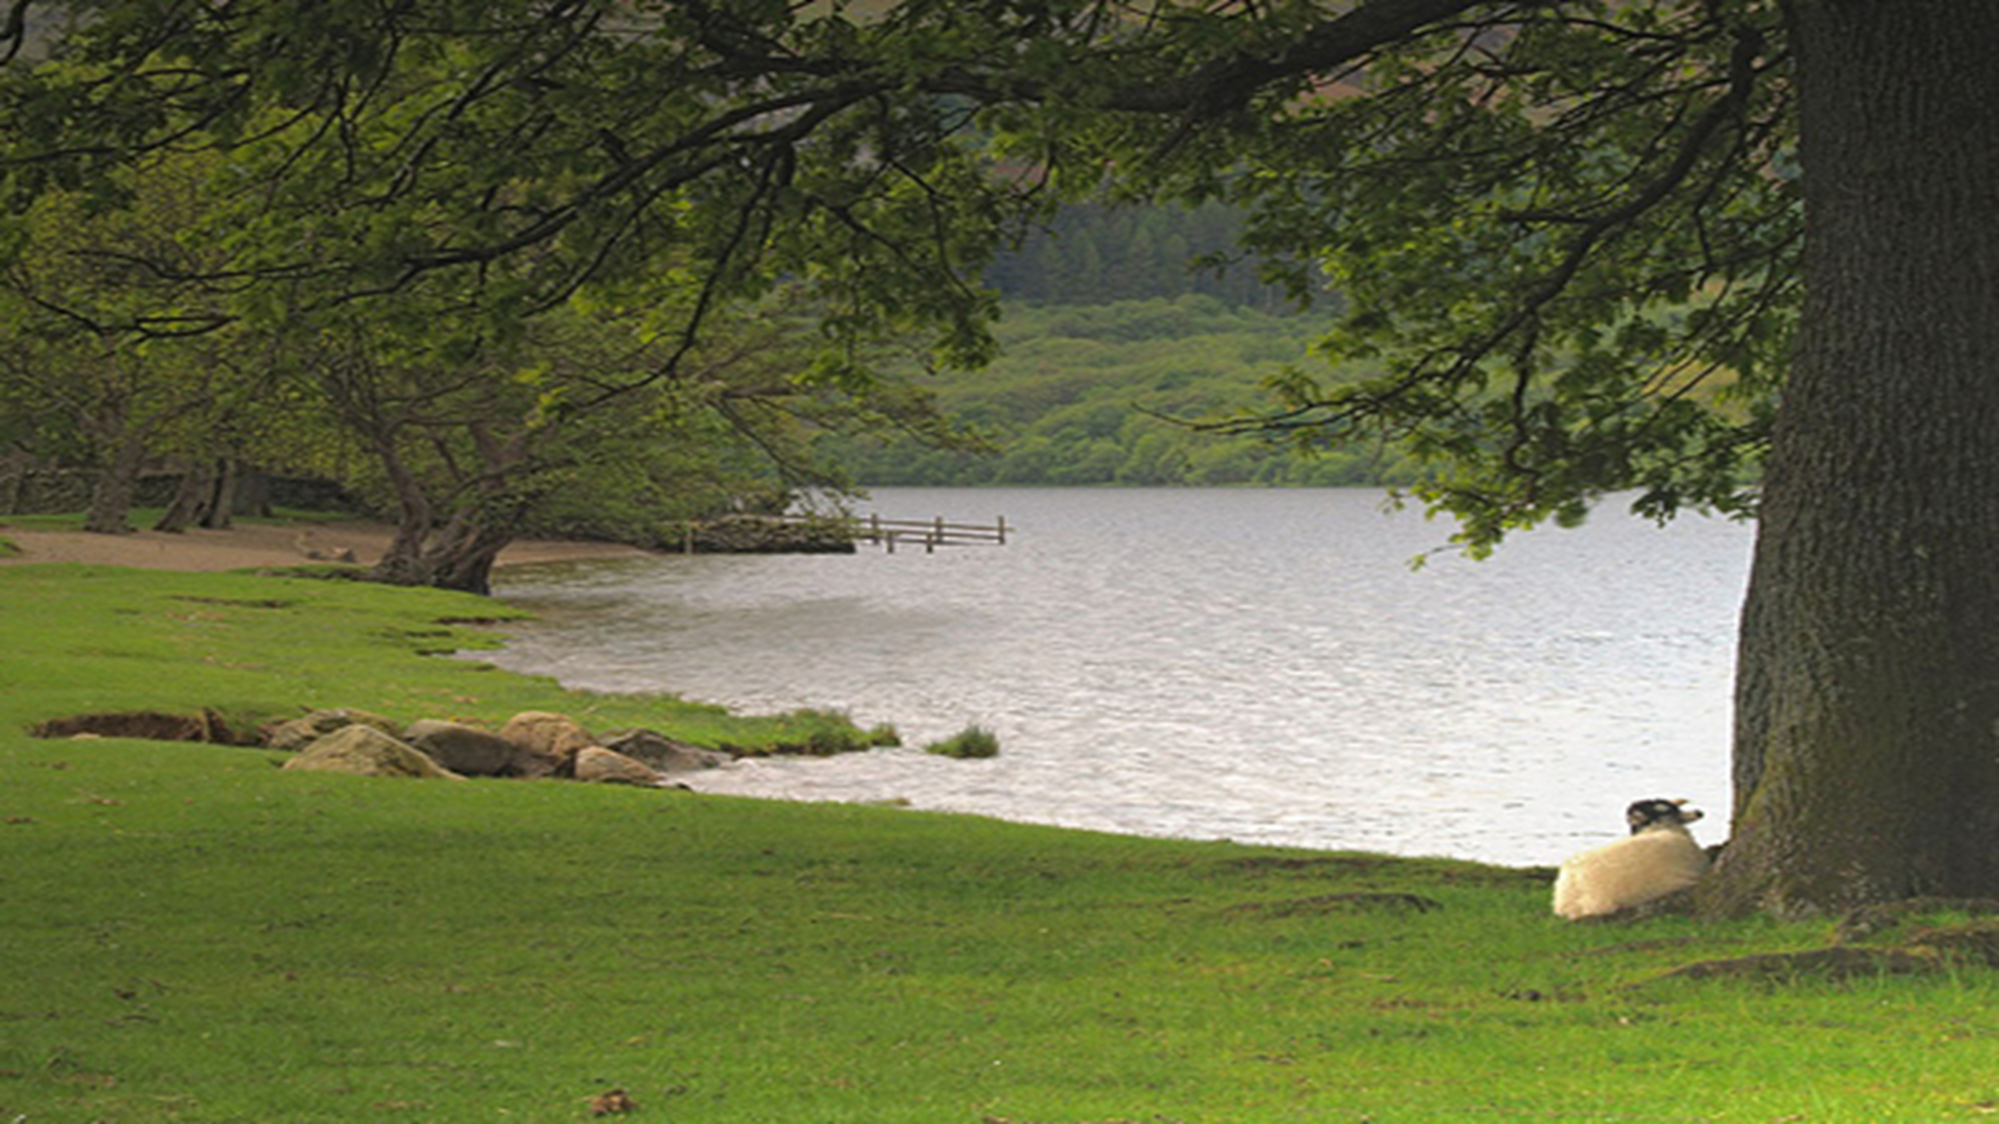
Reignited Faith in a Loving God: A Bible Study Through the Book of 2nd Samuel
LESSON 7: THE REBELLION ENDS
2ND SAMUEL CHAPTERS 17-18
http://candeefick.com/2014/04/beside-still-waters/

Slide 3
CHAPTER 17: DAVID FLEES FROM ABSALOM
Vs. 1-23: Ahithophel and Hushai Give Absalom Contradictory Advice
Ahithophel, the grandfather of Bathsheba [Eliam-Ahithophel’s son and Bathsheba’s father-one of David’s might men; Uriah-Bathsheba’s husband-one of David’s might men.] had been known “as if one inquired of the word of God.” Unfortunately, resentment and pride began to cause his downfall. Ahithophel’s first step in resentment was to attach himself to Absalom. This could have been due to David’s incest with Bathsheba and David’s murder of Uriah.
David’s Route
http://www.jesuswalk.com/david/life_of_david_maps_and_graphics.htm

Slide 4
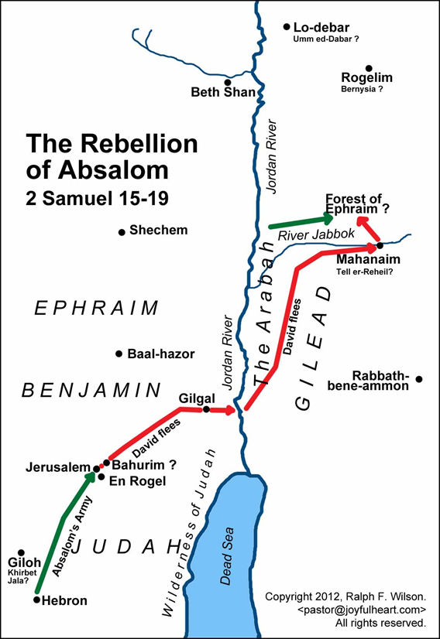
Ahithophel’s next step down the path of pride was advising Absalom to let him lead a 12,000-man army against David. Ahithophel apparently wanted the glory of battle and his revenge against David.
Ahithophel told Absalom that if given 12,000 men, he would attack David while he and his men were weary and exhausted. *
Ahithophel said that he would kill David and bring the kingdom back to Absalom. At first, Absalom was pleased with this plan.
http://www.jesuswalk.com/david/life_of_david_maps_and_graphics.htm
Gilgal- “rolling away” reproach of Egypt-Israel enters Promised Land and is circumcised.

Slide 5
Absalom wanted a second opinion, so he asked Hushai for his advice. Hushai was the official counselor to David who David had sent back to Jerusalem to act as a spy.
David had prayed that the counsel of Ahithophel would be made as foolishness (2 Samuel 15:31-32). God was answering David’s prayer. [*]
Hushai wanted to give David time to prepare for war and to play on Absalom’s pride.
http://www.jesuswalk.com/david/life_of_david_maps_and_graphics.htm

Slide 6
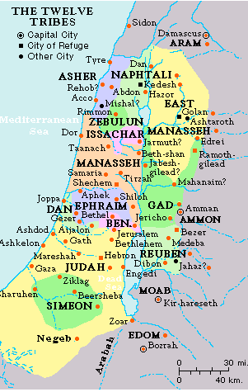
http://jewishhistory2015.blogspot.com/2015/08/the-1920-san-remo-conference-jewish.html
Hushai said Absalom should gather all the men from Dan to Beersheba and that Absalom should lead the army into battle. Furthermore, Hushai stated, if David were to hold himself up in a city, then the army would bring ropes, tear the walls down, and capture David.
Absalom accepted Hushai’s plan and announced that it was better than Ahithophel’s.
https://www.goodsalt.com/details/prcas0690.html

Slide 7
Since Hushai was spying for David, he went to Zadok and to Abiathar the priests and told them to tell David not to spend the night at on the west side of the Jordan but to cross over to the east side. Hushai wanted to make sure David would be safe in case Absalom changed his mind and followed Ahithophel’s advice.
Zadok and Abiathar passed the message on to their sons, Jonathan and Ahimaaz who were staying at En-rogel. They received the message by way of a maidservant. However, a young boy saw the transaction and told Absalom.
http://www.jesuswalk.com/david/life_of_david_maps_and_graphics.htm

Slide 8
Realizing they had been discovered, the two men fled En-rogel and came to a man in Bahurim and they hid in his well. Absalom’s servants could not find the men and they left.
After their departure, Jonathan and Ahimaaz told David to cross over the Jordan to the east side.
When Ahithophel saw that his counsel was not followed, he saddled his donkey, went home, got his house in order, and hanged himself. This is a sad example of what anger, revenge, and pride can do to a person.
http://www.jesuswalk.com/david/life_of_david_maps_and_graphics.htm

Slide 9
Vs. 24-29: David Crosses the Jordan
David came to Mahanaim (ma-ha-naim) [double camp-the angels’ camp and Jacob’s camp prior to wrestling with the angel] while Absalom crossed over the Jordan River. Mahanaim was a city in Gilead where Ish-bosheth reigned over Israel for two years. Apparently, the people of Mahanaim showed David kindness since he had given respect toward Ish-bosheth after his murder. Mahanaim was also the place where God met Jacob after leaving Paddan-aram with Rachel and Leah (Genesis 32:1-2; 9-10). [*]
http://www.jesuswalk.com/david/life_of_david_maps_and_graphics.htm

Slide 10
Absalom also crossed the Jordan river with his army.
When David arrived in Mahanaim, Shobi (sho-be, Machir (match-ear) , and Barzillai (bar-zil-i)brought food and supplies to David and his men. It is interesting to note that Machir took care of Mephibosheth, Jonathan’s son, while Jonathan and Saul were fighting the Philistines (2 Samuel 9:3-5). [*]

Slide 11
CHAPTER 18: ABSALOM IS KILLED IN BATTLE
Vs. 1-33-David’s Warning to His Commanders
David divided his army among Joab, Abishai, and Ittai (2 Samuel 15:19-22). [*]
The people would not let David go out to battle but convinced him to remain in the city (Mahanaim).
As the armies left the city, David gave specific orders to Joab, Abishai, and Ittai not to kill or harm Absalom.

Slide 12
The two armies met in the treacherous forest of Ephraim, north of the Jabbok River. The forest region was so harsh that more people died because of the terrain than they did from the sword.
Absalom’s army was defeated, and 20,000 men died.
As Absalom was riding his mule, his head got caught in the branches of an oak tree and he was suspended in the air.
http://markalburger2009.blogspot.com/2009/04/april-5.html

Slide 13
When Joab was told of Absalom’s situation, Joab rebuked the informer for not killing Absalom. The man stated that he would not defy David’s wishes for Absalom since he knew that David would find out.
Joab took three spears and killed Absalom. Not only did Joab strike Absalom but ten of Joab’s young armor bearers also struck him.
http://www.toptenz.net/10-gruesome-deaths-bible.php

Slide 14
Joab blew his trumpet and recalled his army. He took Absalom’s body, dug a deep pit, threw the body in the pit and covered it with stones. A burial such as this was reserved for a criminal or enemy.
Prior to this, Absalom had set up a monument for himself (probably in the Kidron Valley-just east of Jerusalem). There is a present-day “pillar of Absalom” in the Kidron Valley though it is not this particular one. However, it may be in the same spot. Apparently his sons had died (2 Samuel 18:18; 14:27) [*]
https://dwellingintheword.wordpress.com/2010/11/02/392-2-samuel/

Slide 15
Ahimaaz, the son of Zadok, asked Joab for permission to tell David that they had won the battle, but Joab sent a Cushite instead (Cush was the area south of Egypt).
After the Cushite left, Ahimaaz pleaded with Joab to tell David the news. Joab gave him permission and he ran passed the Cushite.
When David heard that Ahimaaz was running toward the gate, he believed that Ahimaaz was bringing good news. Ahimaaz told David that he had won the battle but did not relay that Absalom was dead .
https://dailyoffice.wordpress.com/2016/08/07/morning-prayer-8-8-16-dominic-priest-friar-1221/

Slide 16
The Cushite arrived shortly after and he also told David that the battle was won. David asked about Absalom and the Cushite answered indirectly that he was dead.
David was deeply grieved. He went up to the chamber over the gate and wept. Scripture records five times the phrase “my son,” indicating David’s great sorrow.
http://library--of--babel.blogspot.com/2013/11/1-2-samuel-hebrew-bibles-best-novel.html

Slide 17
SUMMARY
Proverbs 14:12 states, “There is a way which seems right to a man, but its end is the way of death.” Sin always leads to death. This could be death of the body, soul, or spirit. While sin often appears pleasurable or right-and it may for a time-it will always lead to destruction. Psalm 19:8 states, “The precepts of the Lord are right, rejoicing the heart; the commandment of the Lord is pure, enlightening the eyes.” Righteousness always leads to life, peace, and prosperity; and it is everlasting. Psalm 119:105 states, “Your word is a lamp to my feet and a light to my path.” God’s word will always lead us to righteousness (right-living).

Slide 18
2nd Samuel 15:31-32
31 Now someone told David, saying, "Ahithophel is among the conspirators with Absalom." And David said, "O Lord, I pray, make the counsel of Ahithophel foolishness.“ 32 It happened as David was coming to the summit, where God was worshiped, that behold, Hushai the Archite met him with his coat torn and dust on his head. [*]

Slide 19
Genesis 32:1-2
1Now as Jacob went on his way, the angels of God met him. 2Jacob said when he saw them, "This is God's camp." So he named that place Mahanaim… 9 Jacob said, "O God of my father Abraham and God of my father Isaac, O Lord, who said to me, 'Return to your country and to your relatives, and I will prosper you,’ 10 I am unworthy of all the lovingkindness and of all the faithfulness which You have shown to Your servant; for with my staff only I crossed this Jordan, and now I have become two companies. [*]

Slide 20
2nd Samuel 9:3-5
3 The king said, "Is there not yet anyone of the house of Saul to whom I may show the kindness of God?" And Ziba said to the king, "There is still a son of Jonathan who is crippled in both feet." 4 So the king said to him, "Where is he?" And Ziba said to the king, "Behold, he is in the house of Machir the son of Ammiel in Lo-debar." 5 Then King David sent and brought him from the house of Machir the son of Ammiel, from Lo-debar. [*]

Slide 21
2nd Samuel 15:19-22
19 Then the king said to Ittai the Gittite, "Why will you also go with us? Return and remain with the king, for you are a foreigner and also an exile; return to your own place. 20 You came only yesterday, and shall I today make you wander with us, while I go where I will? Return and take back your brothers; mercy and truth be with you." 21But Ittai answered the king and said, "As the Lord lives, and as my lord the king lives, surely wherever my lord the king may be, whether for death or for life, there also your servant will be." 22 Therefore David said to Ittai, "Go and pass over." So Ittai the Gittite passed over with all his men and all the little ones who were with him. [*]

Slide 22
2nd Samuel 18:18
18 Now Absalom in his lifetime had taken and set up for himself a pillar which is in the King's Valley, for he said, "I have no son to preserve my name." So he named the pillar after his own name, and it is called Absalom's Monument to this day.
2nd Samuel 14:27
27 To Absalom there were born three sons, and one daughter whose name was Tamar; she was a woman of beautiful appearance. [*]

