Slide 1
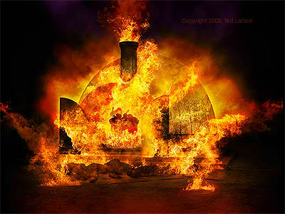
Daniel Chapter 3
The Fiery Furnace

Slide 2
Bibliography
McGee, J. Vernon. Daniel: Thru The Bible Commentary Series-The
Prophets. Tennessee:Thomas Nelson, Inc., 1991.
Ryrie, Charles: Ryrie Study Bible: Expanded Edition. Chicago: The
Moody Bible Institute of Chicago, 1995.
Tucker, Kent: Share Your Faith Ministries, California.
Walvoord, John: Daniel: The Key To Prophetic Revelation. Chicago:
The Moody Bible Institute of Chicago, 1989.
“Scriptures taken from the NEW AMERICAN STANDARD BIBLE®, Copyright © 1960, 1962, 1963, 1968, 1971, 1972, 1973, 1975, 1977, 1995 by The Lockman Foundation. Used by permission.”

Slide 3
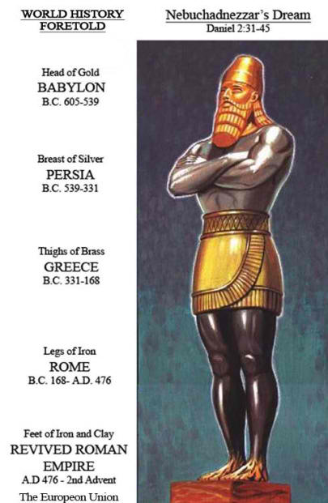

Slide 4
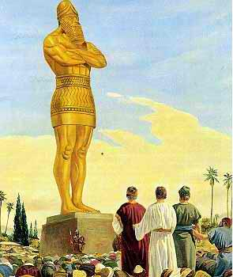
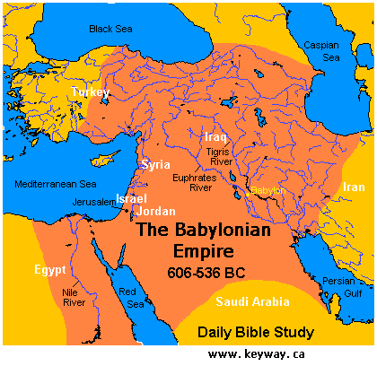
Vs. 1
This image would have been 90 feet high and 9 feet wide. It could have been solid gold or wooden with a gold overlay. The image was set up on the plain of Dura which was possibly a mound six miles southeast of Babylon.

Slide 5
The nature of this image is very interesting in light of the image in chapter 2.
Nebuchadnezzar’s dream portrayed a great statue of which the head was made of Gold.
In the interpretation of the dream, Daniel explained the head of gold represented King Nebuchadnezzar.
Daniel also explained Nebuchadnezzar’s empire would not last but would fall to another kingdom.

Slide 6
Nebuchadnezzar was a very proud and arrogant King who demanded absolute loyalty and sought absolute power. The idea of his kingdom not lasting was probably too much for Nebuchadnezzar to accept.
It is quite possible Nebuchadnezzar erected this statue of pure gold in defiance to Daniel’s interpretation of the dream in chapter 2. [*]

Slide 7
Nebuchadnezzar might have wanted to show the world his kingdom was everlasting.
It could also be Nebuchadnezzar’s statue was a replica of the one he saw in the vision.

Slide 8
Vs. 2-3
King Nebuchadnezzar assembled the officials of surrounding areas to pay homage to this statue.
It is interesting to note that some of these officials were Persian and the place of assembly was toward the empire of Persia.
Might King Nebuchadnezzar have guessed Persia to be the second empire? This could explain why the assemblage was limited to the officials of surrounding areas.

Slide 9
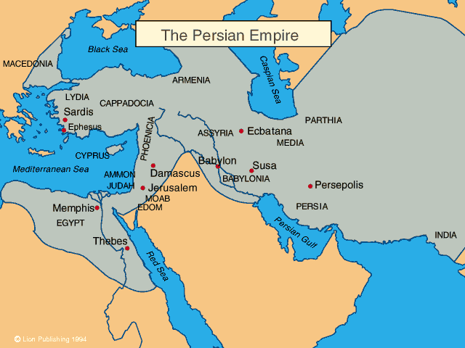
Babylonian Empire
The Persian Empire

Slide 10
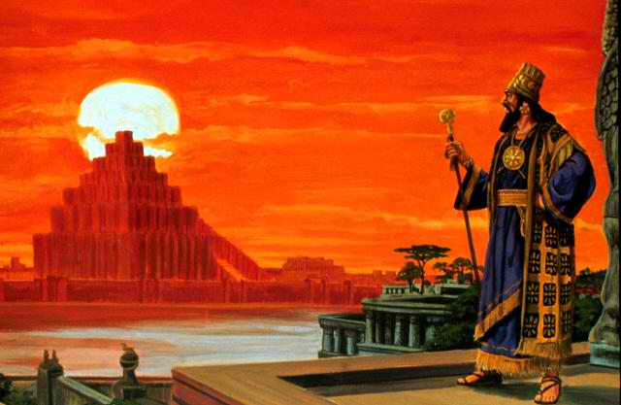
Vs. 4-7
Since King Nebuchadnezzar controlled the ancient world at this time, he could demand complete homage to himself and to his image.

Slide 11
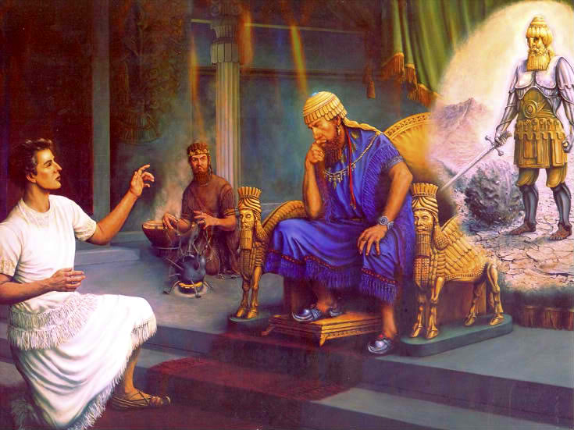
Vs. 8-12
Certain Chaldeans brought charges of defiance to King Nebuchadnezzar which implicated Shadrach, Meshach, and Abed-nego.
Remember who the Chaldeans were? They had been the most significant astrologers in Daniel 2. These astrologers were the ones who could not interpret Nebuchadnezzar’s dream and were threatened with death.

Slide 12
After Daniel interpreted the dream, he, Shadrach, Meshach, and Abed-nego were elevated to extremely high positions.
It is possible these Chaldeans were jealous and humiliated by these Israelites and wanted them executed.

Slide 13
Vs. 13-18
Nebuchadnezzar’s great image appears to be much more than a religious symbol. Chances are it was the representation of the longevity of Nebuchadnezzar’s empire.

Slide 14
Shadrach, Meshach, and Abed-nego refused to worship:
Nebuchadnezzar’s gods
Nor his image (3:18)
It is very possible Daniel’s three friends realized that defiance to the image would be defiance to Nebuchadnezzar's hope of unlimited Babylonian rule.

Slide 15
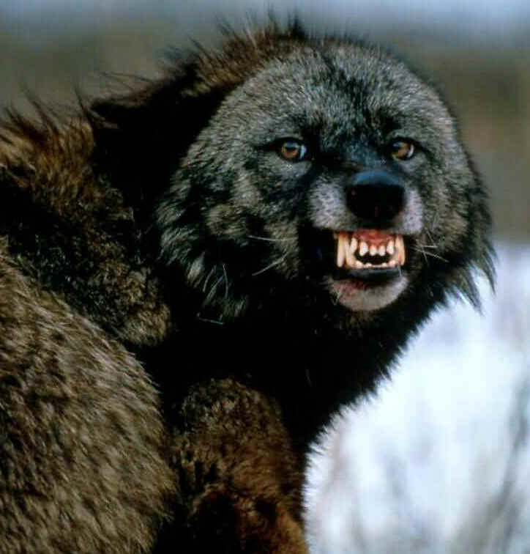
Vs. 19-23
Nebuchadnezzar’s wrath was so extreme his facial expression altered. Nebuchadnezzar flew into a fit of rage.
Again, if this image was defiance toward God’s message of limited reign, one can understand Nebuchadnezzar's extreme emotional rage. Not only was Shadrach, Meshach, and Abed-nego refusing to worship Nebuchadnezzar’s gods, they were refusing to admit Babylon’s everlasting rule.

Slide 16
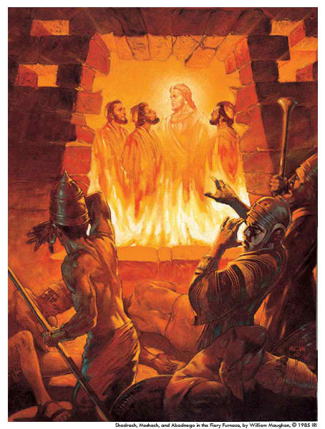
Vs. 24-27
Who was this fourth man? Jesus, the deliverer of all sin.
Other Old Testament appearances of Jesus are found in:
Genesis 16:9-“Then the angel of the Lord (Yahweh) said to her (Hagar)…” [*]

Slide 17
Genesis 18:1-“Now the Lord (Yahweh) appeared to him (Abraham) by the oaks of Mamre…”
Exodus 3:2-“The angel of the Lord appeared to him (Moses) in a blazing fire from the midst of a bush…”

Slide 18
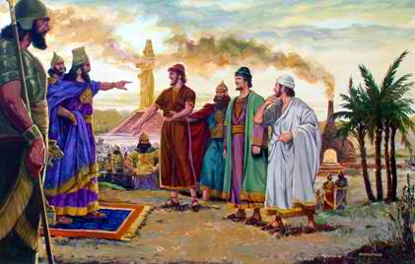
Vs 28-30
King Nebuchadnezzar recognized the sovereignty of Shadrach, Meshach, and Abed-nego’s God and made a decree to honor their God.
Nebuchadnezzar elevated and prospered Shadrach, Meshach, and Abed-nego.

Slide 19
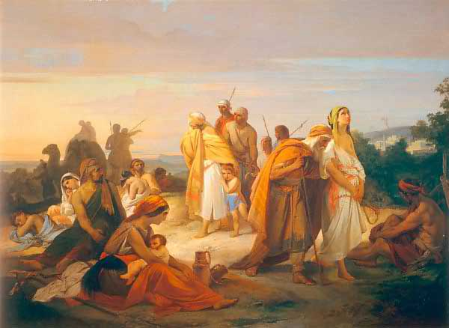
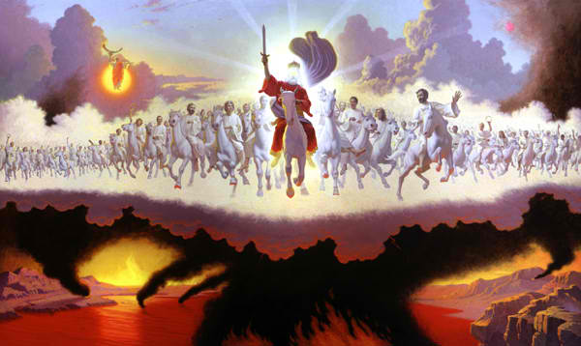
Interpretation
The book of Daniel is a representation of events from Israel’s first captivity in 605 B.C. to the Second Coming of Christ.
As with many prophets of the Old Testament, it is quite possible Daniel represented the nation of Israel. King Nebuchadnezzar, on the other hand, possibly represented all the worldly and evil forces against Israel.

Slide 20
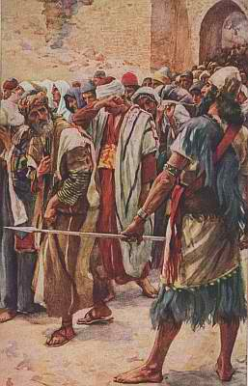
The Israelites knew God had driven them from the “Promised Land” and were now serving a heathen god in a heathen country.
Israel was experiencing the rejection and shame for straying so far from God and His Laws.

Slide 21
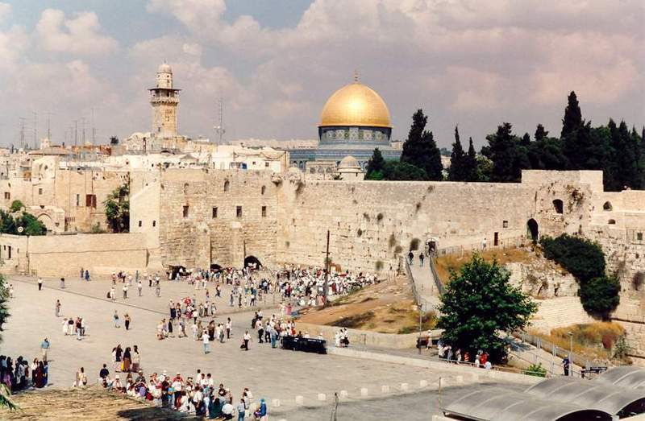
Through all of this, God wanted to show Israel He was with them and they still had a place in His future plans.
As God was using Daniel to minister in Nebuchadnezzar’s court, Ezekiel was ministering to the other exiled Jews.

Slide 22
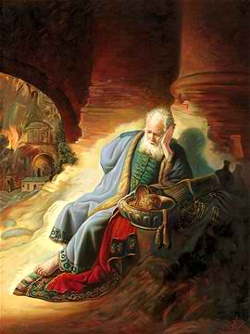
God often used prophets and contemporary events as a representation of things to come. Sometimes a prophet was told not to marry (Jeremiah) or to marry an unfaithful wife (Hosea) in order to show Israel’s rejection of God’s laws.
As Shadrach, Meshach, Abed-nego, and Daniel were delivered from the furnace and the lions’ den, so will Israel be delivered from ultimate destruction.

Slide 23
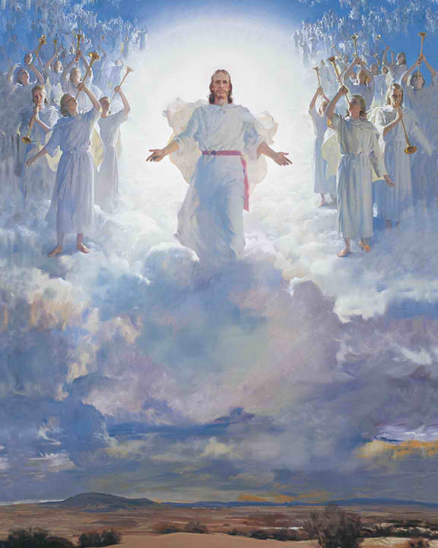
Some have wondered why Daniel was not present in the fiery furnace story. Daniel may have been out of the area on official business. Daniel’s absence could represent the Christian Jews who will be raptured before the Tribulation period.
It could be King Nebuchadnezzar did not want Daniel present since both would know the meaning and defiance of the great statue.

Slide 24
Shadrach, Meshach, and Abed-nego could represent the 144,000 Christian Jews who will be delivered from the trials of the Great Tribulation.

Slide 25
It is difficult to know whether King Nebuchadnezzar had a heart rendering change and accepted the God of Israel or if he only experienced a cognitive knowledge of God.
Romans 14:11 states, “…As I live, says the Lord, every knee shall bow to me, and every tongue shall give praise to God.”

Slide 26
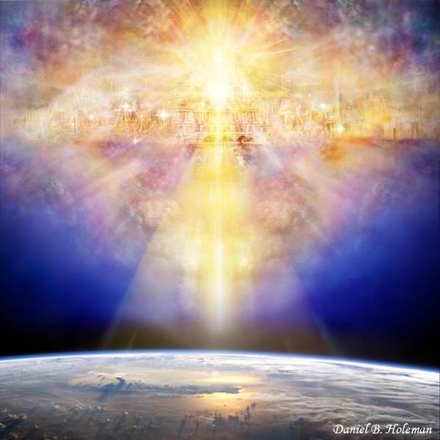
Deuteronomy 31:6 was reminding the Jews that, “He (the Lord God) will not fail you (them) or forsake you (them).”
God was encouraging Israel and reminding them of His unfailing love and His ultimate plan for their future.
End-----

Slide 27
Genesis 16:9
Then the angel of the Lord said to her, "Return to your mistress, and submit yourself to her authority." 10Moreover, the angel of the Lord said to her, "I will greatly multiply your descendants so that they will be too many to count." [*]

Slide 28
Daniel 2
37 You, O king, are the king of kings, to whom the God of heaven has given the kingdom, the power, the strength and the glory; 38 and wherever the sons of men dwell, or the beasts of the field, or the birds of the sky, He has given them into your hand and has caused you to rule over them all. You are the head of gold. 39After you there will arise another kingdom inferior to you, then another third kingdom of bronze, which will rule over all the earth.[*]

